Slide 1
Decoding Cognitive States

Slide 2
Introduction
Want to decode cognitive states from subjects while performing therapy or training to provide real-time neuro-feedback

Slide 3
Cognitive states
What do I mean by cognitive state?

Slide 4
PTSD Exctinction Therapy

Slide 5
ADHD real-time neuro-feedback therapy

Slide 6
Introduction
Requires robust individual decoding in complex environment
Very different from existing decoding methods
Want to create general and individual models tailored to specific training/therapy stimuli
No consistent model for higher-level cognitive tasks
Instead we build model from data
Want to be able to translate to neuroscience
Possibility for pharmaceutical insights etc.

Slide 7
fMRI or EEG?
EEG
Inexpensive
Mobile
Low spatial resolution
High temporal resolution
FMRI
Expensive
Subject cannot move
High spatial resolution
Low temporal resolution
Want to be able to leverage more data and translate to neuroscience
fMRI has larger existing public datasets that can be reasonably combined
The higher spatial resolution of fMRI and the difficulty of the inverse problem in EEG means registering datasets together is much easier in fMRI
Many existing neuroscience meta-studies that already leverage this advantage (refs)
Can eventually translate models to EEG using simultaneous fMRI/EEG recordings (ref)

Slide 8
fMRI constraints
Subject cannot move and the scanner is loud and cumbersome
Focus on virtual reality training/therapy, e.g., PTSD ref
Want to minimize time in scanner
Temporal resolution is limited ~0.5 Hz
May need to modify stimulus to accommodate
Curse of dimensionality for machine learning algorithms
Dimensionality is much higher than the number of samples that can be reasonably collected

Slide 9
Objectives
Maximize decoding accuracy
Run in real-time
Visualize models in the brain

Slide 10
Decoding Background
Many examples of cognitive states
Object categories
What a person is saying and who is saying it
Telling the truth or lying
Planning vs executing
Highly controlled stimuli
Unclear if results translate to more realistic stimuli
Focus on proving localized significant effect
No attempts to maximize decoding accuracy
Limits use of more advanced machine learning algorithms

Slide 11
Maximize Decoding Accuracy
Leverage knowledge of the structure of the individuals brain
Preprocessing to maximize signal-to-noise and reduce redundant dimensionality
Leverage data from many sessions and subjects
Requires meaningful cross-session and subject alignment of data
Eases dimensionality problem
Allows more advance machine learning techniques to be used
Reduces training data required per subject
Leverage temporal structure efficiently
Incorporating time directly into machine learning model increases dimensionality too quickly
Instead use temporal filtering to improve accuracy

Slide 12
Real-time Background
Very limited
Best example is online training of an SVM at a very simple decoding task
No online registration methods
Can't leverage multiple sessions or pretrained models

Slide 13
Mapping Background
GLM
Simple yet powerful for showing significant localized correlations
However, is linear and univariate and therefore cannot capture complicated patterns of activation
Searchlight
Perform machine learning on small kernels of voxels
Can capture non-linear effects but still cannot account for large spatial patterns
Absolute Discriminate Map
Visualize weights of model directly
Resulting maps can be highly dependent on regularization of the model
Easy to visualize when model is linear and model dimensionality is the same as input dimensionality
How can we generalize to non-linear and complex models?

Slide 14
Maximize Decoding Accuracy
Leverage knowledge of the structure of the individuals brain
Preprocessing to maximize signal-to-noise and reduce redundant dimensionality
Leverage data from many sessions and subjects
Requires meaningful cross-session and subject alignment of data
Eases dimensionality problem
Allows more advance machine learning techniques to be used
Reduces training data required per subject
Leverage temporal structure efficiently
Incorporating time directly into machine learning model increases dimensionality too quickly
Instead use temporal filtering to improve accuracy

Slide 15
Run in real-time
Perform model training off-line
Requires on-line registration to model
Most machine learning algorithms are already fast enough at decoding
Temporal filtering will introduce output delay
Need to tune accuracy tradeoff with acceptable delay

Slide 16
Visualize models in the brain
Want to be able to visualize trained models in the brain
Useful for debugging and formulating neuroscience hypotheses
Multivariate and non-linear models can be hard to visualize in only three dimensions

Slide 17
Work completed
Build virtual environment and stimuli for testing
Intended to be visually similar to environments used in current virtual reality PTSD extinction therapies
Build stimuli within this virtual environment to test decoding methods
Develop video processing techniques to minimize low level contrast variations in real-time
Maximize decoding accuracy
Established baseline decoding performance for complex virtual reality stimulus with common machine learning algorithms
Developed and evaluated temporal filtering techniques to improve decoding accuracy
Evaluated common fMRI preprocessing methods with respect to decoding accuracy
Run in real-time
Created robust and automated registration pipeline that can be used in real-time
Visualize models
Adapted sensitivity analysis (ref) for visualization purposes
Can be applied to nearly all machine learning algorithms

Slide 18
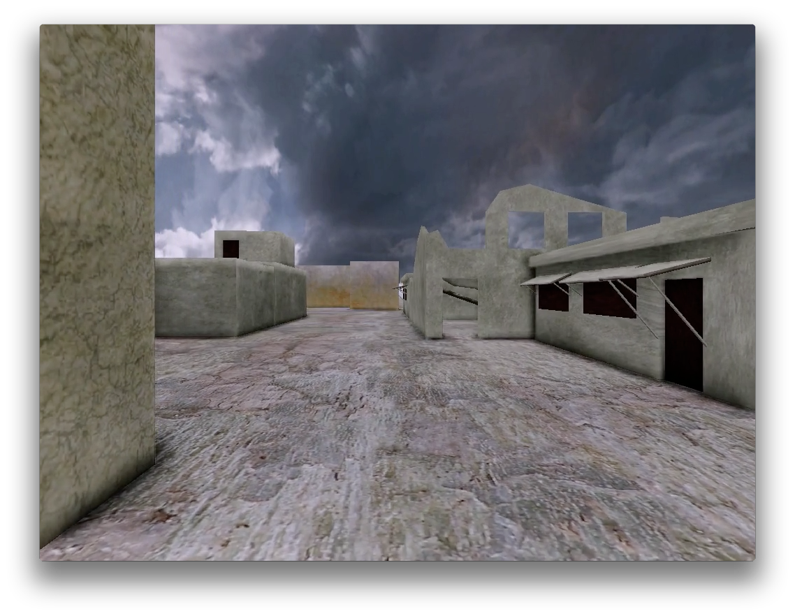
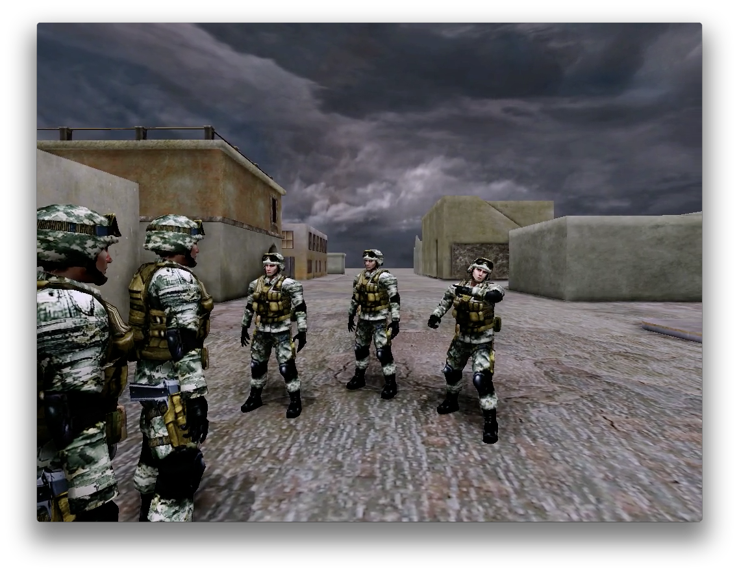
Virtual Environment V.1
Decoding number of characters

Slide 19
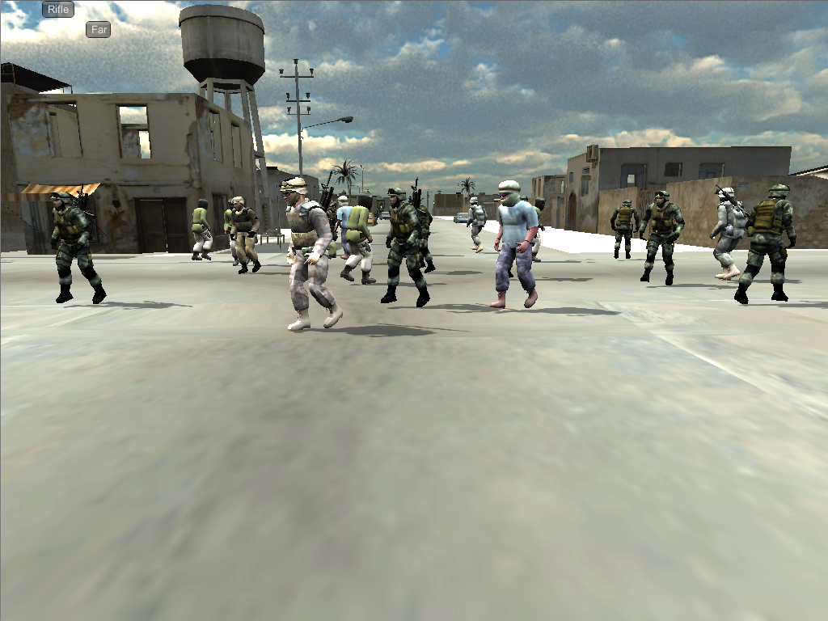
Virtual Environment V.2
Decoding performance at weapon detection task

Slide 20
Establish baseline decoding accuracy
Baseline performance decoding number of characters for 4 popular machine learning algorithms

Slide 21
Evaluate temporal filtering techniques

Slide 22
Evaluated fMRI preprocessing methods
Motion and slice-timing correction greatly benefit decoding accuracy
Weiner filtering better than simple time shifting to correct for hemodynamic response
(smoothing and surface projection figures)

Slide 23
Robust registration pipeline
test
Functional scan session
Structural scan session
(offline)
Functional scan sessions
(online)
Structural
Skull-strip
normalize
Inplane
scan
Robust
register
Functional scans
Motion
and
slice-timing
Functional
Skull-strip
normalize
Surface
volumes
Spherical
Template
registration
Boundary
Based
registration
Smoothing
And
Surface
projection

Slide 24
Mapping
Sensitivity Analysis
Differentiate decoder outputs with respect to inputs
Evaluate derivative on every training example
Calculate RMS value across examples
Left with a map the size of the input dimension for each output
Can examine individually or aggregate across outputs
For linear SVM simplifies to absolute discriminate map

Slide 25
Thresholding
Reasonable thresholding of the map can be achieved via recursive feature elimination
Threshold selected when classifier performance not significantly different from chance

Slide 26
Mapping

Slide 27
Future Work
Continue to improve classification accuracy
Hidden Markov Model approach to temporal filtering
Use structural and functional connectivity to improve smoothing and constrain models

Slide 28
Hidden Markov Model
Current temporal filters rely on knowledge of block structure of stimuli
In a practical application, the block structure would be unknown
Treat cognitive state transitions for a particular task as a hidden Markov model
Use a machine learning algorithm (neural network for example) to estimate prior probability of a state given the signal at a particular time step
Calculate most likely sequence of states over a fixed number of observations based on probability output
The transition probability matrix can be easily estimated from the group data since no registration is required

Slide 29
Leverage HCP
Human Connectome Project has a massive collection of subjects (>1000) with anatomic, structural connectivity, resting state, and functional scans collected
Use our existing anatomic and resting state scans along with the database to predict structural and functional connectivity for our subjects
The current smoothing algorithm can be replaced with an anisotropic diffusion method where the diffusion coefficient is calculated from structural and functional connectivity
This encourages smoothing within functional regions
Structural and functional connectivity estimates can be used to constrain connectivity in a searchlight procedure or when training a neural network

Slide 30
Connectivity Distance

Slide 31
Questions?

